Slide 1

Spatial Accessibility Analysis
Hosur, India
Kaviyarasu Anbalagan

Slide 2
Introduction – Project Story
This project analyses spatial accessibility to essential services in Hosur, India.
Focus on healthcare and education availability around residential locations.
Goal: identify underserved homes, distance-based healthcare risk, and service imbalance patterns.
Demonstrates how spatial databases reveal insights not visible in tabular data.

Slide 3
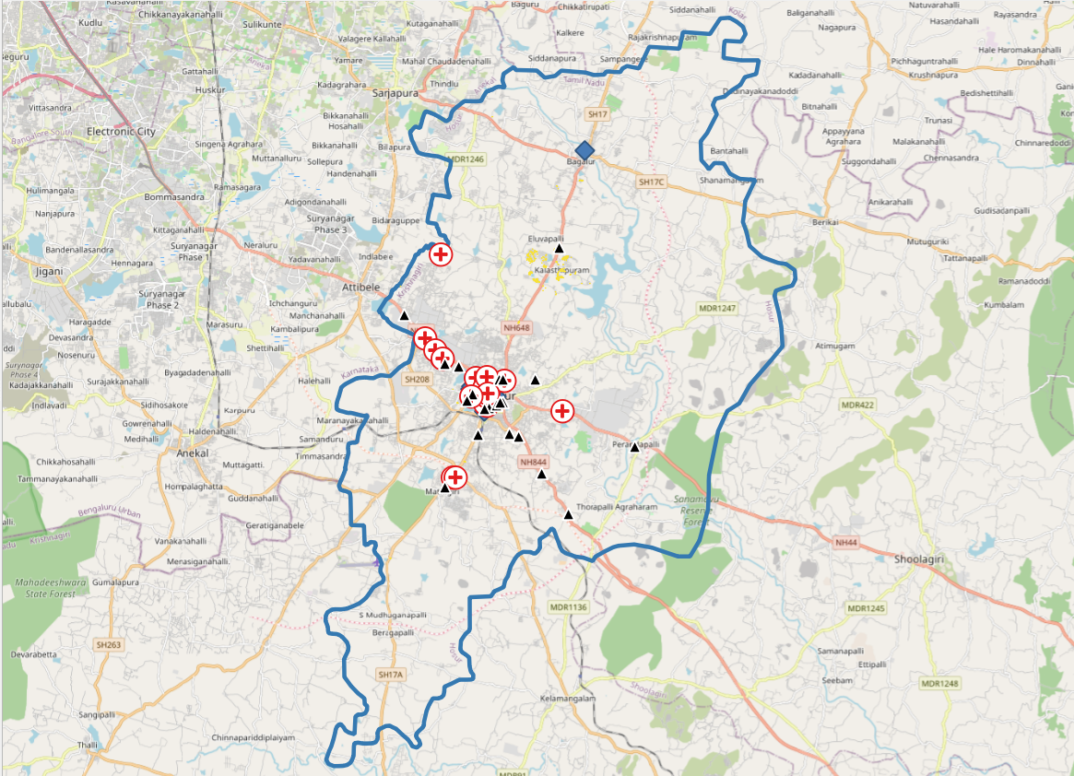
Study Area – Hosur, India
Hosur boundary and study area

Slide 4
Data Acquisition
Data sourced from OpenStreetMap (OSM).
Datasets used: Homes, Hospitals, Clinics, Schools.
Data restricted to Hosur region.
Residential features without names were assigned synthetic identifiers for clarity.

Slide 5
Tools and Technologies
QGIS for visualization and spatial processing.
PostgreSQL with PostGIS extension for spatial analysis.
Coordinate Reference System: EPSG:3857 (meters) for distance calculations.

Slide 6
Methodology Overview
Spatial SQL used for distance-based analysis.
Key functions: ST_DWithin, ST_Distance, spatial buffers.
Combination of SQL analysis and GIS visualization.

Slide 7
Analysis 1 – Underserved Homes
Question: Which homes lack hospital access within 5 km?
Approach: Create 5 km buffer around hospitals.
Homes outside buffer classified as underserved.

Slide 8
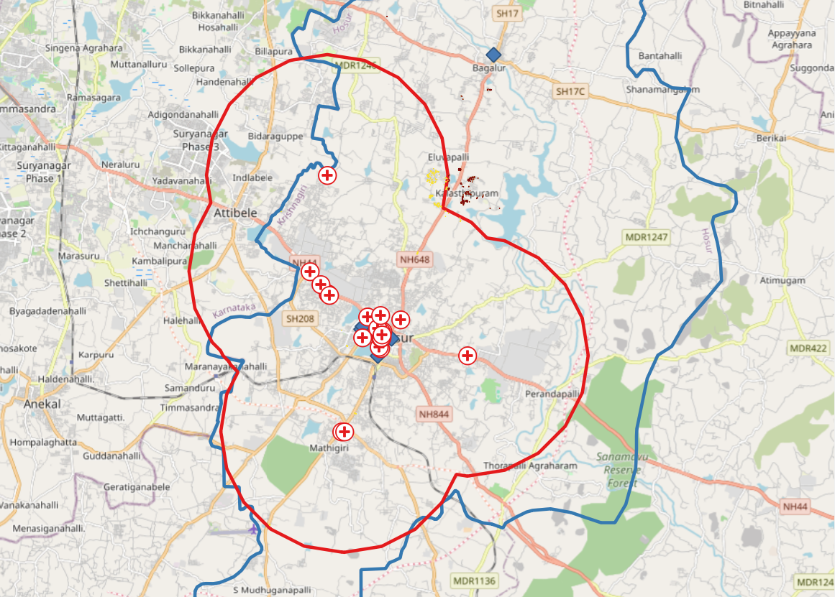
Map 1 – Underserved Homes

Slide 9
Analysis 2 – Nearest Healthcare
Question: How far does each home travel to reach nearest healthcare facility?
Nearest-neighbour analysis using ST_Distance.
Includes hospitals and clinics.

Slide 10
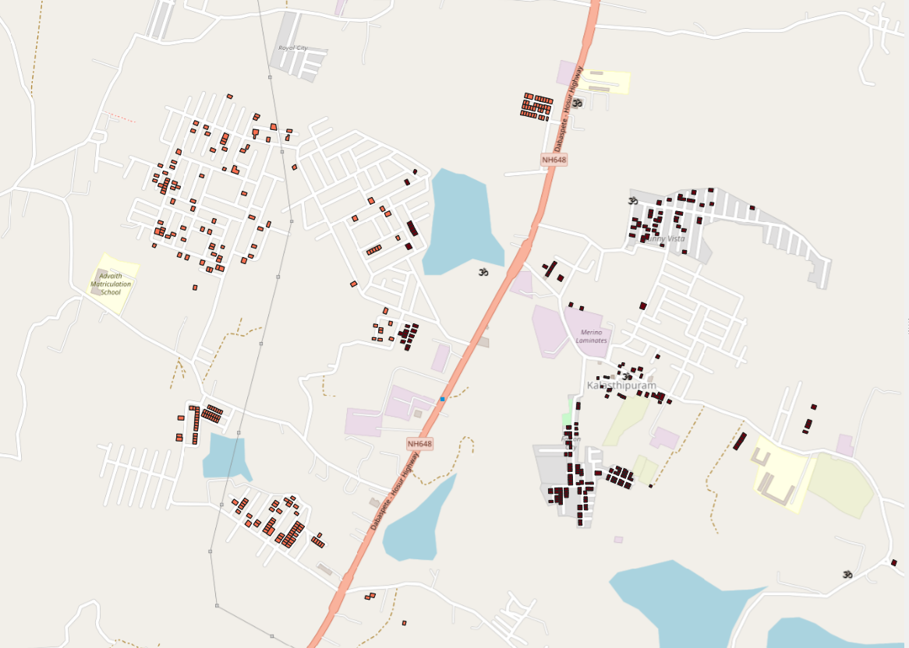

Map 2 – Nearest Healthcare Distance

Slide 11
Analysis 3 – Service Imbalance
Question: Is access to schools balanced with access to hospitals?
Counts of schools and hospitals within 3 km of each home.
Imbalance score = schools minus hospitals.

Slide 12
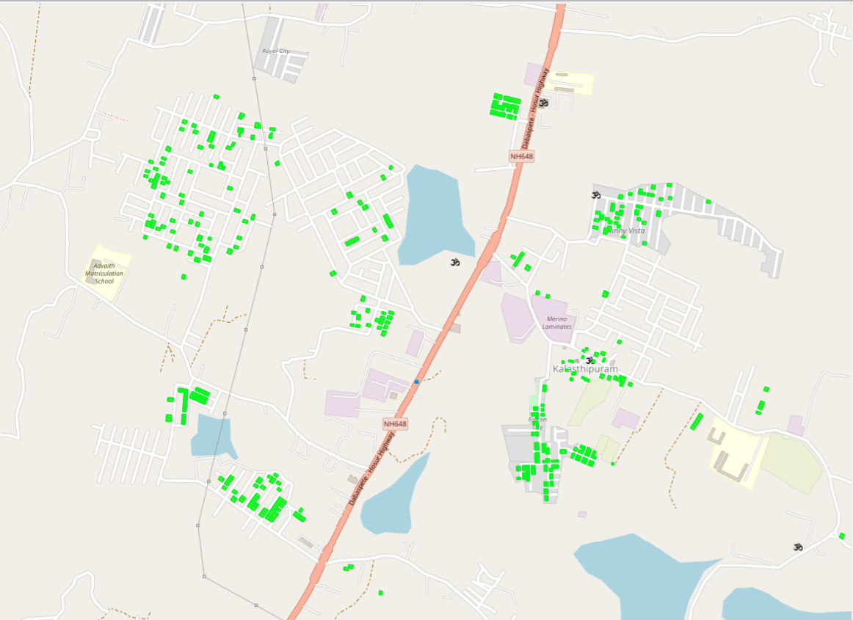

Map 3 – Education vs Healthcare Imbalance

Slide 13
Key Observations
Central Hosur shows relatively good service coverage.
Peripheral areas are consistently underserved, especially in healthcare.
Educational access does not guarantee healthcare access.

Slide 14
Conclusions
Spatial analysis reveals healthcare accessibility gaps in Hosur.
Distance-based and buffer analyses complement each other.
Spatial databases are essential for informed urban and service planning.

Slide 15
Thank you

